Slide 1
Initiating a Project

Slide 2
Initiating a Project
PRINCE2® manual page 149
Workbook page 237

Slide 3
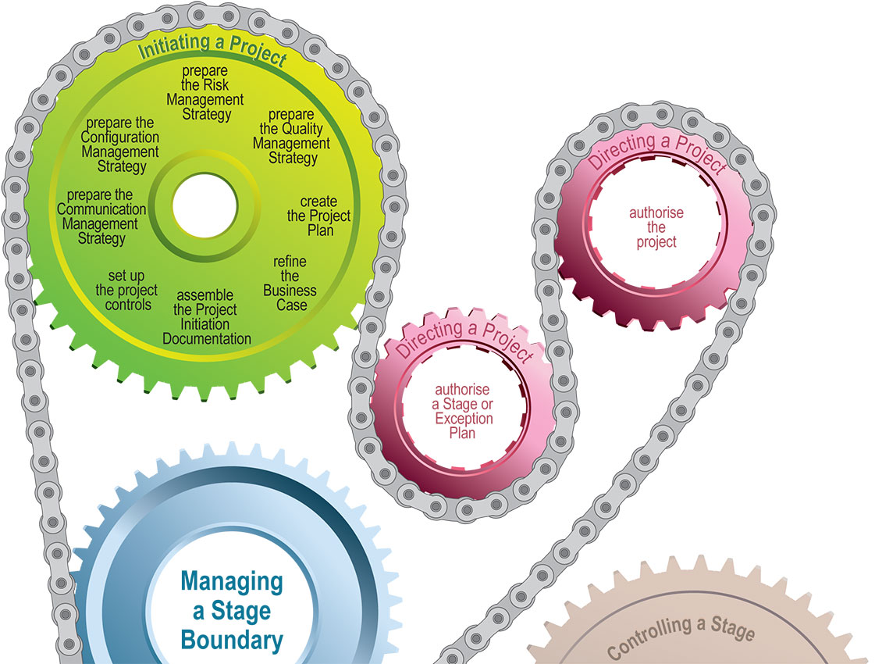
Initiating a Project
Process

Slide 4
Initiating a Project
Introduction
There are 4 strategies
  Risk, quality, configuration and communication
Final deliverable is Project Initiation Documentation
Establishes the reason for the project: Business Case

Slide 5
Initiating a Project
Objectives
Create the strategies
Set up controls, create the project plan
Refine the Business Case
Assemble the PID

Slide 6
Initiating a Project
Activities
Prepare the:
  Risk Management Strategy
  Configuration Management Strategy
  Quality Management Strategy
  Communication Management Strategy
When doing so:
  Review the Project Brief
  Seek lessons
  Review logs and create registers
  Consult with project Assurance, seek Project Board approval

Slide 7
Initiating a Project
Activities
Set up the project controls
  Includes reporting frequency, stages, tolerances
  Depends on scale, risk complexity and importance of the project
Create the Project Plan
  To identify control points, used as a baseline for Project Board

Slide 8
Initiating a Project
Activities
Refine the Business Case
  Justify by balancing cost against benefits
  Created along side the Benefits Review Plan
Assemble the Project Initiation Documentation
  Basis for management and assessment of overall success
  Forms the contract between the Project Manager and Project Board.

Slide 9
Initiating a Project
Principles
Continued business justification
Learn from experience
Defined roles and responsibilities
Manage by stages
Manage by exception
Focus on products
Tailor to suit project environment

